Slide 1
CucONNECT
Project by: Team 41
Jayakrishnan HJ
Richard Noronha

Slide 2
Summary
CUConnect is an online portal for CU students and past pupils to connect with each other
In this portal, the users can connect, share content, and add each other as friends
Implemented Strategy and MVC

Slide 3


Slide 4
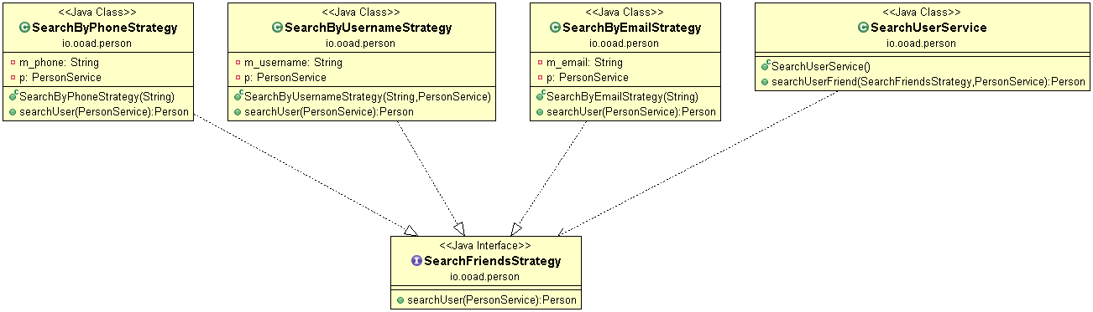
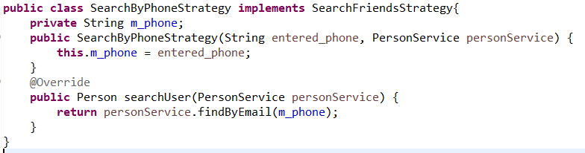
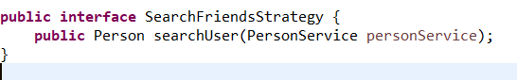
Strategy Design

Slide 5
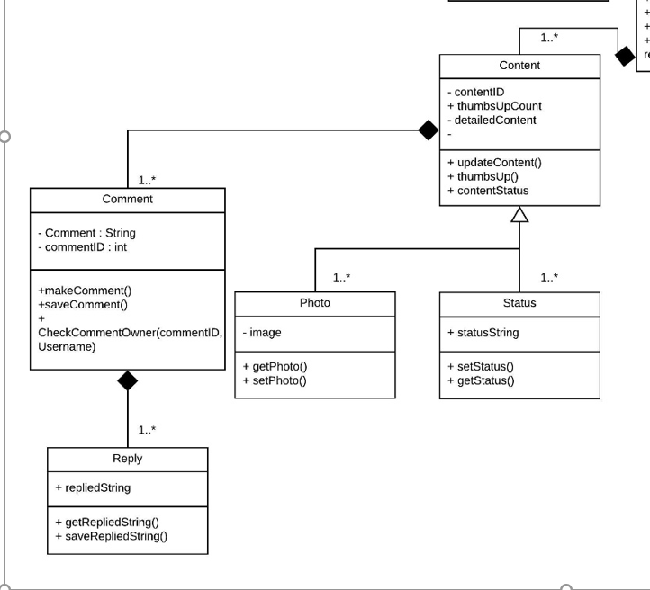
Composite Design Pattern

Slide 6
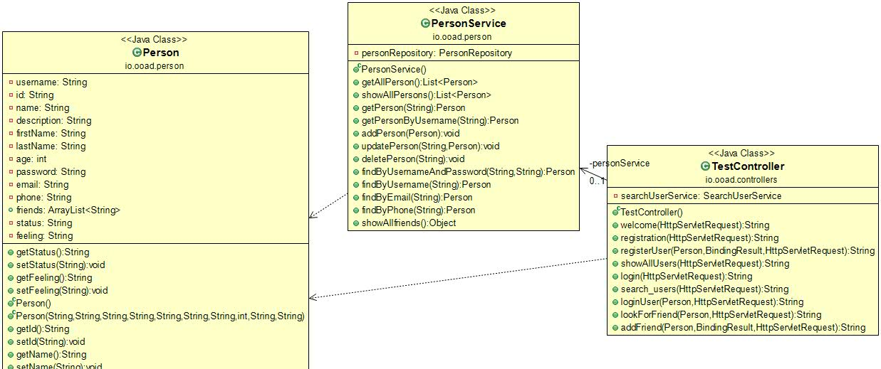
MVC

